Slide 1
Leading Education for Sustainable Futures in South African Technical High Schools
By: Prof Kat Yassim
Department of Education Leadership and Management

Slide 2
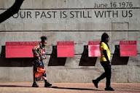
June 16 – A Leadership Mirror
June 16, 1976 was not only about student resistance it was about:
  Educational injustice
  Curriculum control
  Exclusion from meaningful knowledge and skills
The struggle was not just for access to schooling but for dignified, relevant, and empowering education.
Today’s question for leadership:
Have technical high schools become spaces of liberation and opportunity that leads to sustainable education?

Slide 3

Sustainable Development Goals

Slide 4
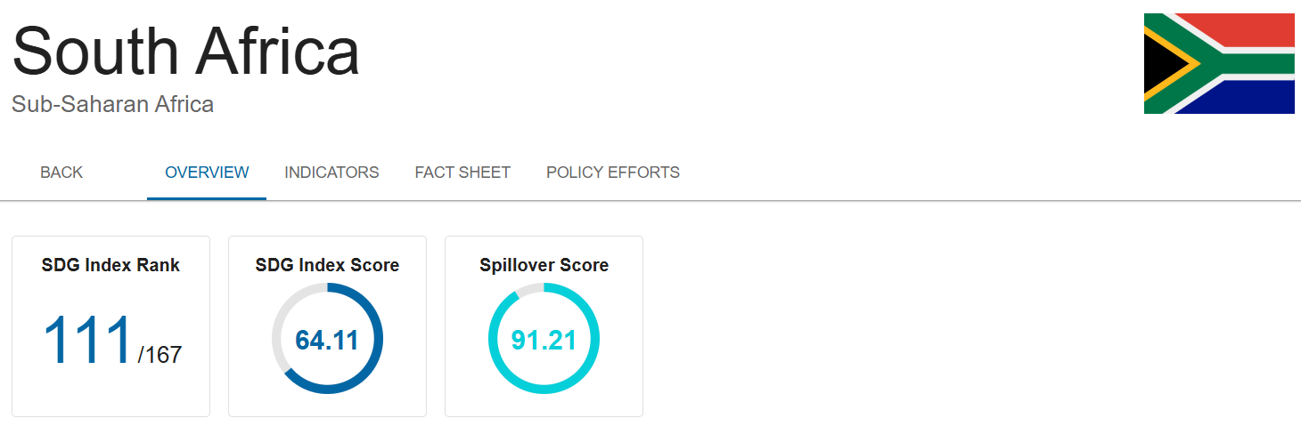
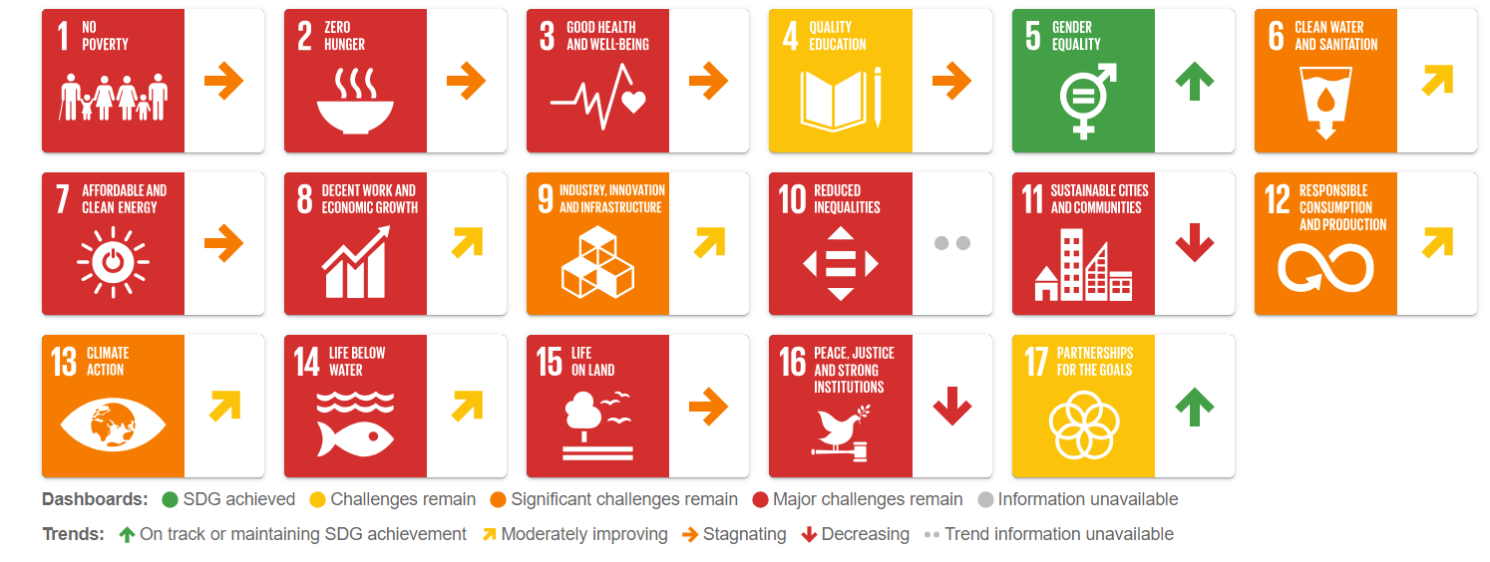

Slide 5
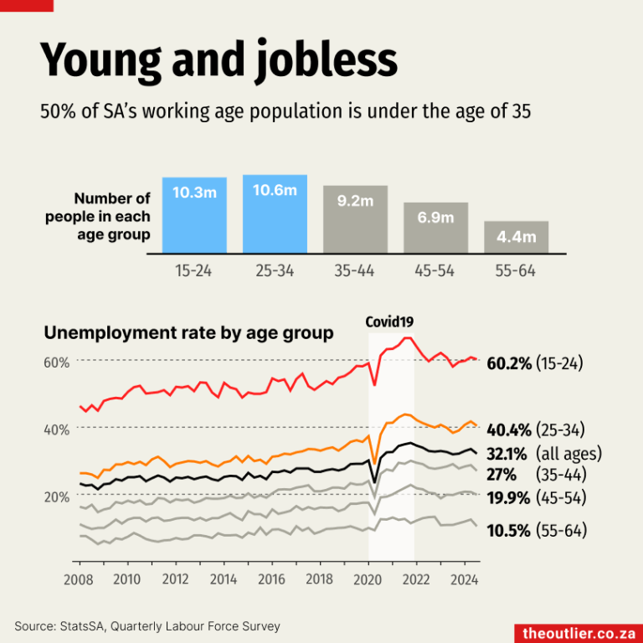
Geographical disparities
The Western Cape, reports the lowest unemployment rates, currently below 30%,
Highest Unemployment Rates = Eastern Cape, North West, and Free State, between 36% and 37%

Slide 6
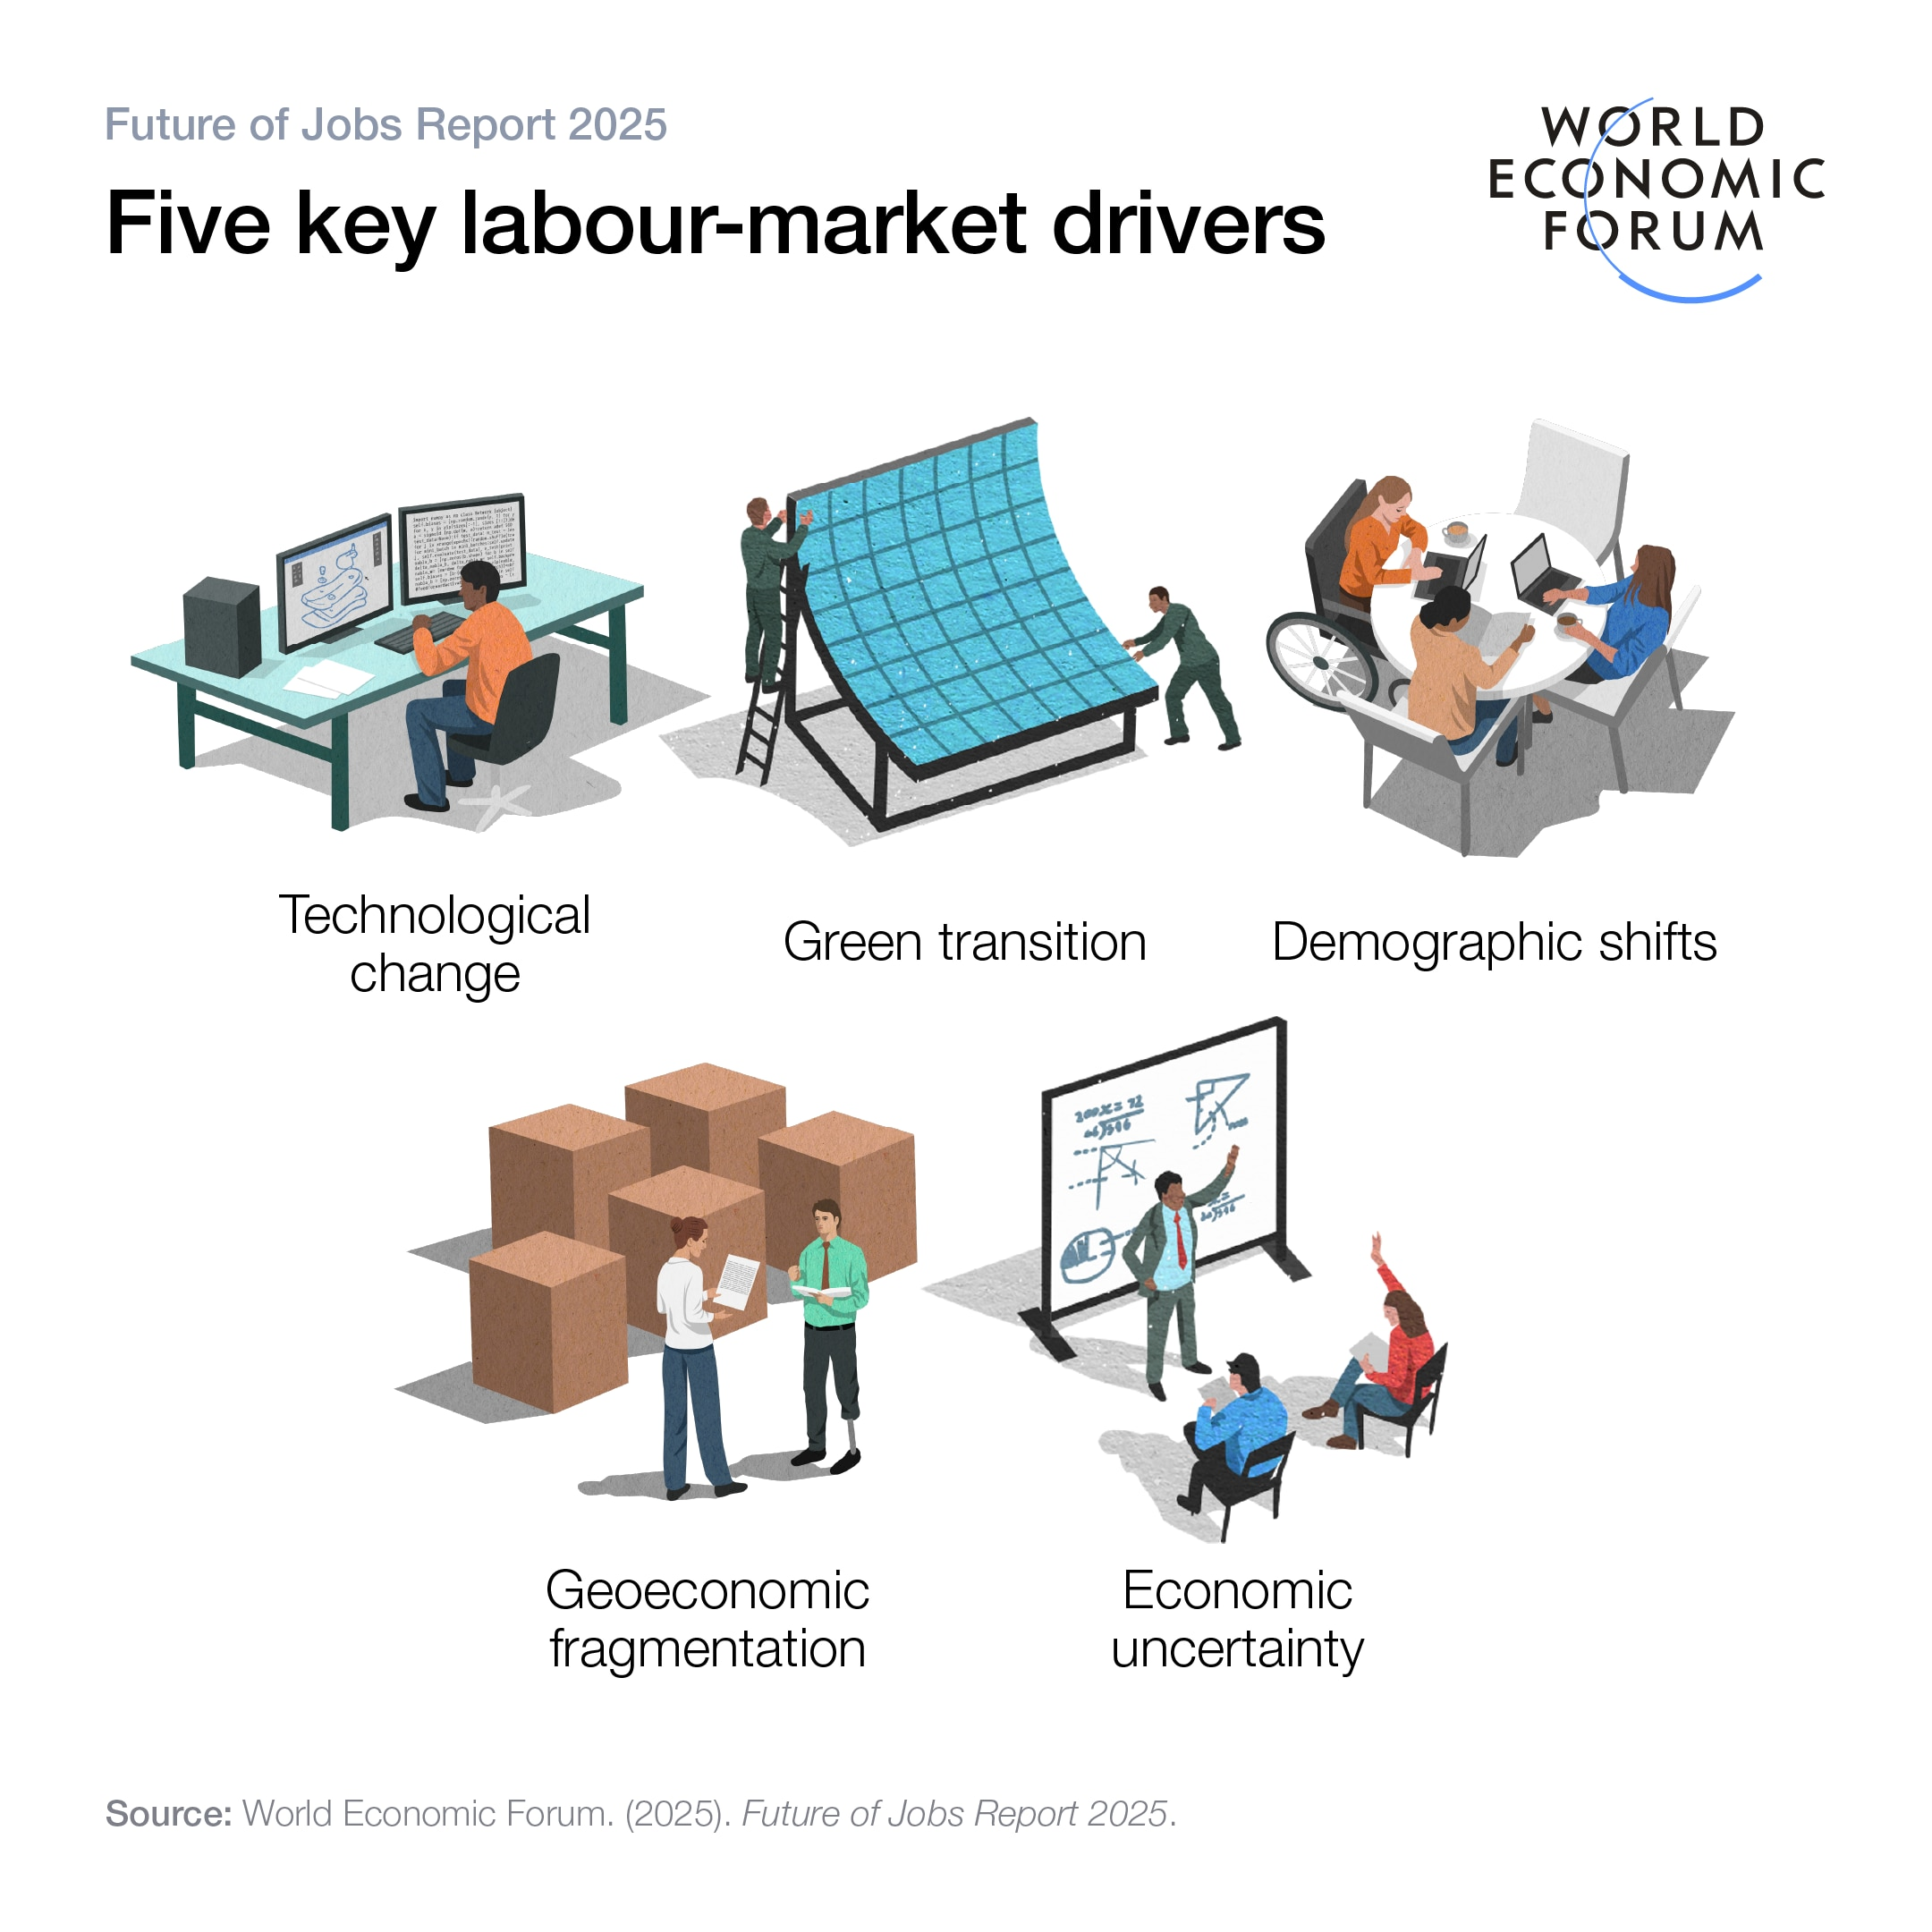

Slide 7
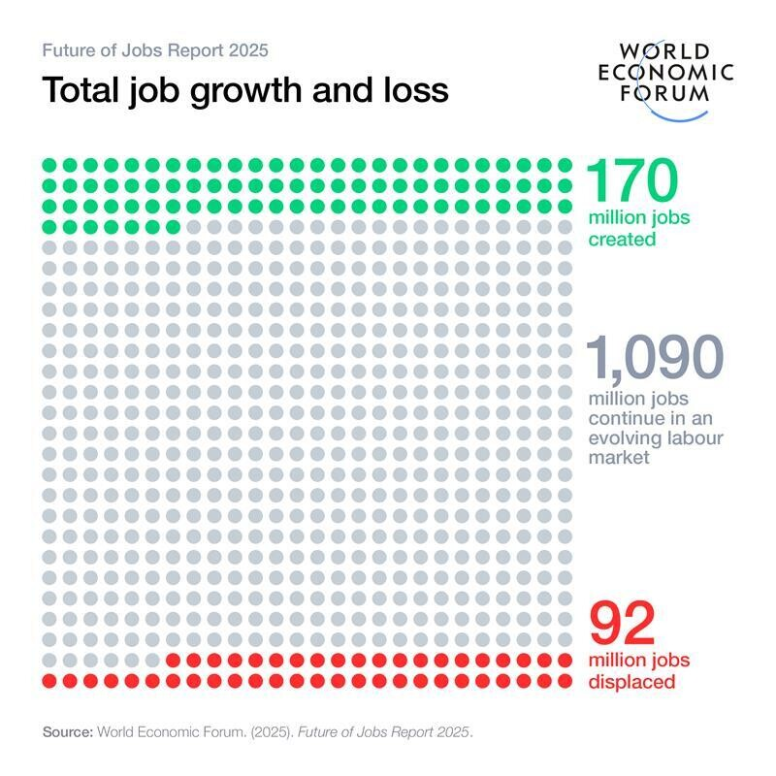

Slide 8
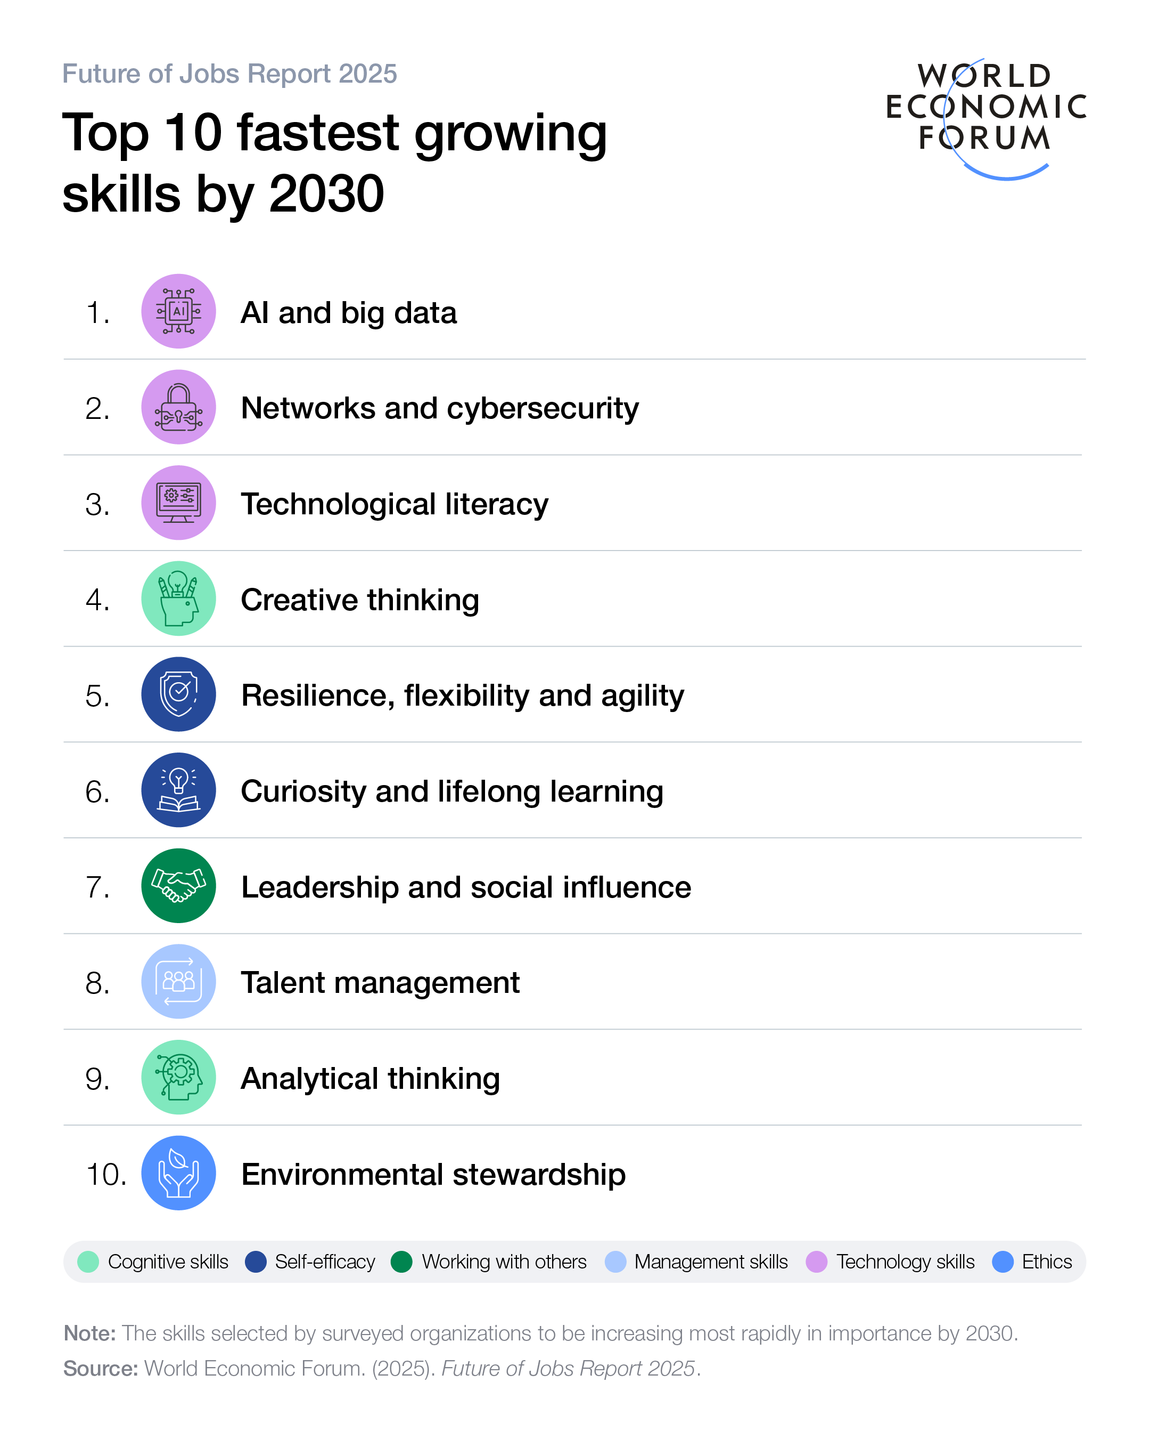

Slide 9
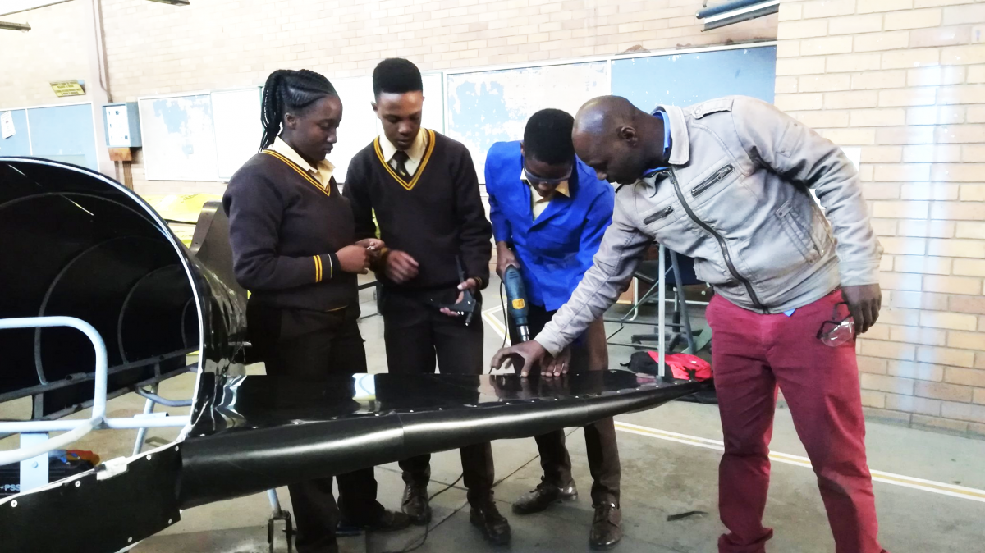
What Gains Have We Made?
Access and Policy Transformation
Technical subjects are now embedded in the national CAPS curriculum
Expansion of technical high schools and streams
Stronger alignment with skills development agenda
Recognition of Technical Pathways
Shift (slow but visible) toward valuing:
  Artisanship
  Vocational excellence
National emphasis on scarce and critical skills

Slide 10
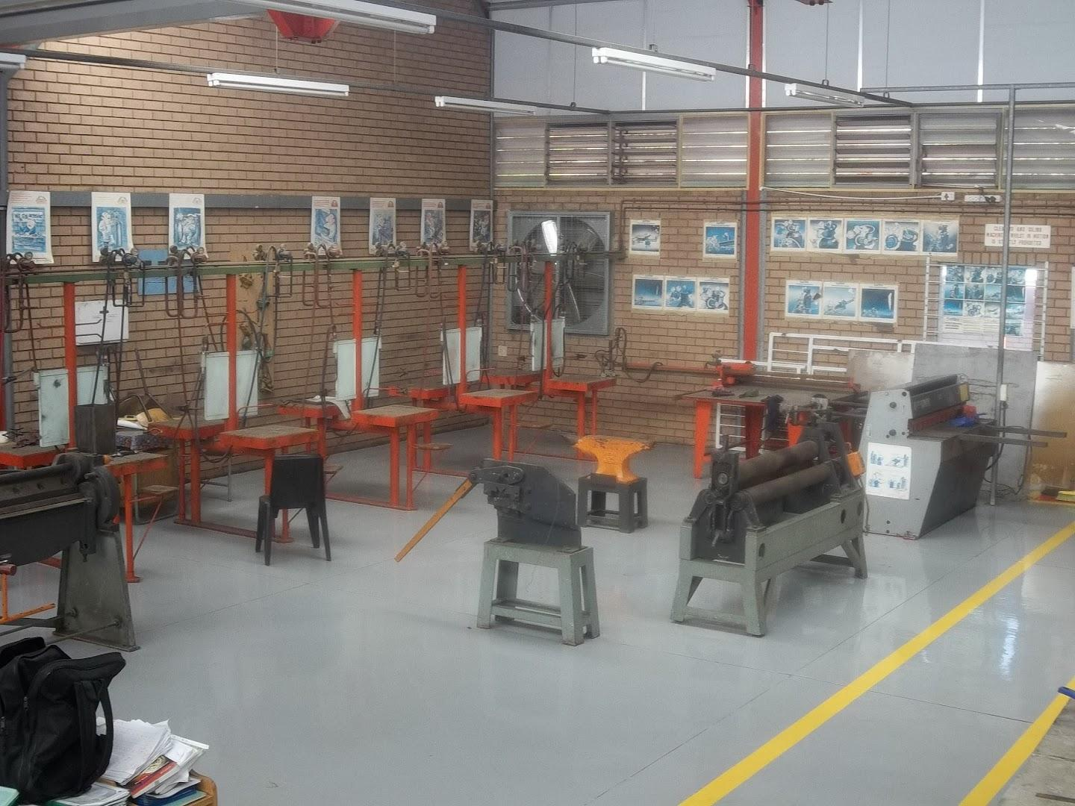
Persistent Inequalities
Former Model C / well-resourced technical schools:
  Advanced workshops
  CAD, robotics, digital tools
  Entrepreneurship Education
Township/rural technical schools:
  Broken equipment
  Limited consumables
  Safety constraints in workshops
This reflects a continuation of apartheid spatial inequality

Slide 11
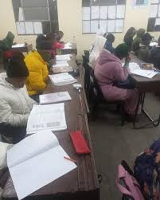
Curriculum Constraints
Technical subjects still often:
  Overly theoretical in assessment
  Under-supported in practice
Weak integration of:
  Indigenous knowledge systems
  Sustainability practices
  Local community technologies
  Industry partnerships

Slide 12
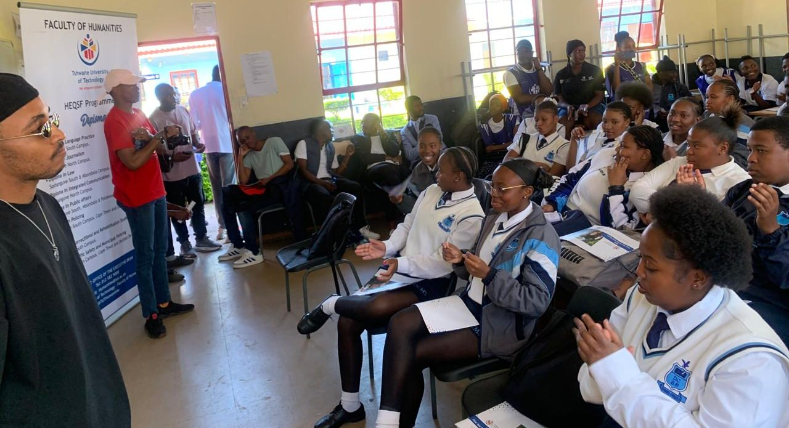
Leadership Inhibitors
School leaders managing:
  Budget constraints
  Infrastructure deficits
  Teacher shortages in technical subjects
Limited autonomy in curriculum innovation

Slide 13
Reframing Technical Schools as Sites of Innovation
Leadership can reposition technical schools as:
Green technology hubs
Community problem-solving centres
Spaces of entrepreneurship
This aligns strongly with:
Sustainability
Decolonial practice
African-centred innovation

Slide 14
Distributed and Collaborative Leadership
Hope is not in heroic principals but in:
Teacher leadership in workshops
Partnerships with:
  Industry
  TVET colleges
  Local artisans
Leadership becomes:
“Relational, networked, and community-embedded”

Slide 15
Decolonising Technical Education
A powerful hope trajectory:
Recognising indigenous technologies:
  Building methods
  Environmental practices
  Craft traditions
Reframing technical knowledge as:
  Not only Western-industrial
  But locally relevant and culturally embedded

Slide 16
Youth Agency and Voice
June 16 reminds us:
👉 Students are not passive recipients—they are agents
Hope lies in leaders who:
Incorporate student voice in decision-making
Support:
  Innovation clubs
  Maker spaces
  Student-led projects

Slide 17
“We are not where we should be… but we are not where we were.”
Challenge | Leadership Opportunity
Inequality in resources | Advocate and mobilise partnerships
Outdated curriculum | Innovate locally within constraints
Skills gaps | Build industry-linked ecosystems
Negative perceptions | Rebrand technical education as aspirational

Slide 18
CLOSING STATEMENT
A June 16 Leadership Call
“The learners of 1976 demanded the right to meaningful education.
Today, the responsibility lies with leadership to ensure that technical schools do not merely produce workers—but empower thinkers, innovators, and citizens.”

